Slide 1


Agile Project
Management
PREPARED BY
18DCS007 | RUDRA BARAD
18DCS024 | HET GALIA
18DCS030 | MANAN JOSHi
6CSE1 : A-B Batch
SUPERVISOR
Prof. Kirti Makwana
CS346 - Software Engineering

Slide 2
TABLE OF CONTENT
01
What is Traditional Project Management?
02
What is Agile Project Management?
06
03
Implementation of JIRA in Software Group Project
Traditional and Agile Project Management Approach
05
04
Discovering and Using
JIRA Tool
Advantages and Growing trends in Agile

Slide 3
WHAT IS TRADITIONAL PROJECT MANAGEMENT ?
Traditional project management is a universal practice that includes a set of developed techniques used for planning, estimating, and controlling activities.
Partially based on waterfall model.
All process phase occurs in sequence(Linear Approach).
Entire project is planned upfront.
Possibility of future modification is completely ignored.

Slide 4
TRADITIONAL PROJECT MANAGEMENT APPROACH
3. Design
4. Build
3
4
An overview of the entire project
Coding and Developing the Product.
2. Feasibility
5. Test
Understanding the customer’s requirement & determining various strategies to solve it
2
5
Testing the product that we developed.
1
6
1. Requirement Collection
6. Installation
All possible requirements are captured and documented
The product is deployed in customers environment

Slide 5
WHAT IS AGILE PROJECT MANAGEMENT ?
Agile project management is iterative approach to delivering a project throughout its life cycle.
it delves into evolving changes and collaborative effort to bring out results rather than a predefined process.
Provides flexibility for project modifications at any stage.
Most of the project planning takes place at runtime thus makes it flexible.

Slide 6
ADVANTAGES OF AGILE
QUALITY PRODUCTS
INCREASED FLEXIBILITY
Iterative nature allows teams to learn and improvise frequently
Making changes at runtime makes it extremely flexible
03
04
BETTER CONTROL
CONTINUOUS IMPROVEMENT
Due to transparency, feedback integration and quality control
02
05
Iterative approach will reflect Mistakes from previous cycle which will be avoided
IMPROVED PRODUCT PREDICTABILITY
01
06
MORE RELEVANT METRICS
With increased visibility, predicting risks, and coming up with effective mitigation plans becomes easier
Agile emphasizes on producing results and optimizing performance

Slide 7
CHALLENGES ENCOUNTERED IN SHIFTING TOWARDS AGILE
39%
Availability of resources with Agile delivery
41%
LImited suitability for Systems
44%
Scaling Beyond Team Travel
48%
Flawless Operations
Culture and performance management
59%

Slide 8
AGILE TOOLS
JIRA AGILE
01
JIRA is a defect tracking and project management agile tool.
MONDAY.COM
02
It is a flexible online tool that can be modified for teams working on agile as well hybrid methodologies
HIVE
03
One of the best tools powered with AI analytics and flexible project views.

Slide 9
1
TRACKING
JIRA supports a great feature of progress tracking
4
BUGS
DISCOVERING
JIRA
Easy to report and solve bugs across multiple teams
2
SUPPORT
Support hybrid methodology working.
5
PRODUCTIVE
Easy to assign tasks to individual to increase productivity
3
BOARDS
Supports multiple workspace such as kanban boards

Slide 10
USE OF JIRA IN INDUSTRY
JIRA with its varied set of features is very much popular project management tool in the industry.
It helps and encourages knowledge sharing amongst the team members.
JIRA allows teams to report bugs and have assistance for it in moments. Thus boosting efficiency to a great extent.
Using JIRA, parent company can also keep track of projects carried out by all its financed companies.

Slide 11
USE OF AGILE PRINCIPLE AND APPROACHES IN DIFFERENT FIELDS
91%
77%
IT SECTOR
62%
59%
BUSINESS
UNIT
53%
OTHER
BUSINESSES
MARKETING AND SALES
BACK
OFFICE

Slide 12
Using JIRA for Software Group Projects
Using JIRA for SGP helped creating a smooth workflow.
JIRA helped us in assign and understand role of each member for the project.
Information and material sharing was made extremely easy with JIRA.
Bug tracking feature helped us a lot for reporting and focusing on solving the errors.

Slide 13
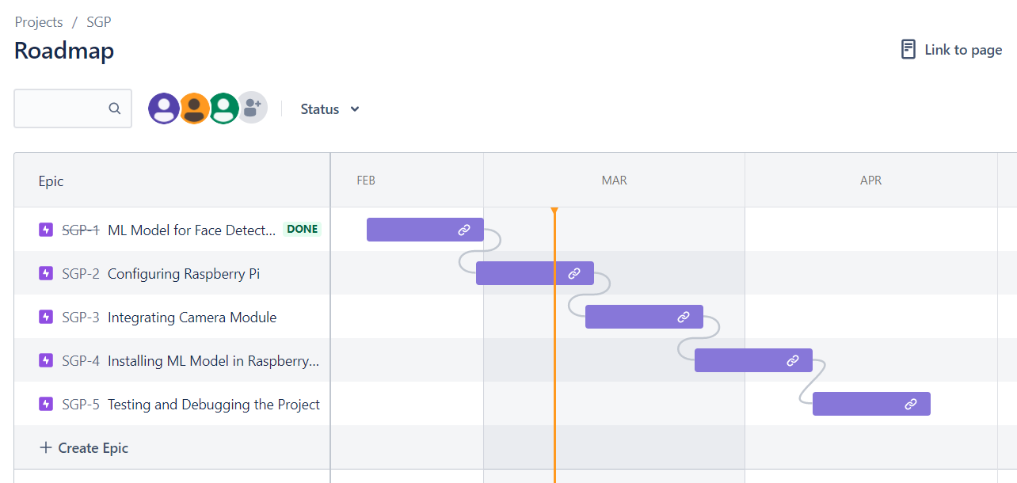
IMPLEMENTATION OF JIRA IN SGP

Slide 14
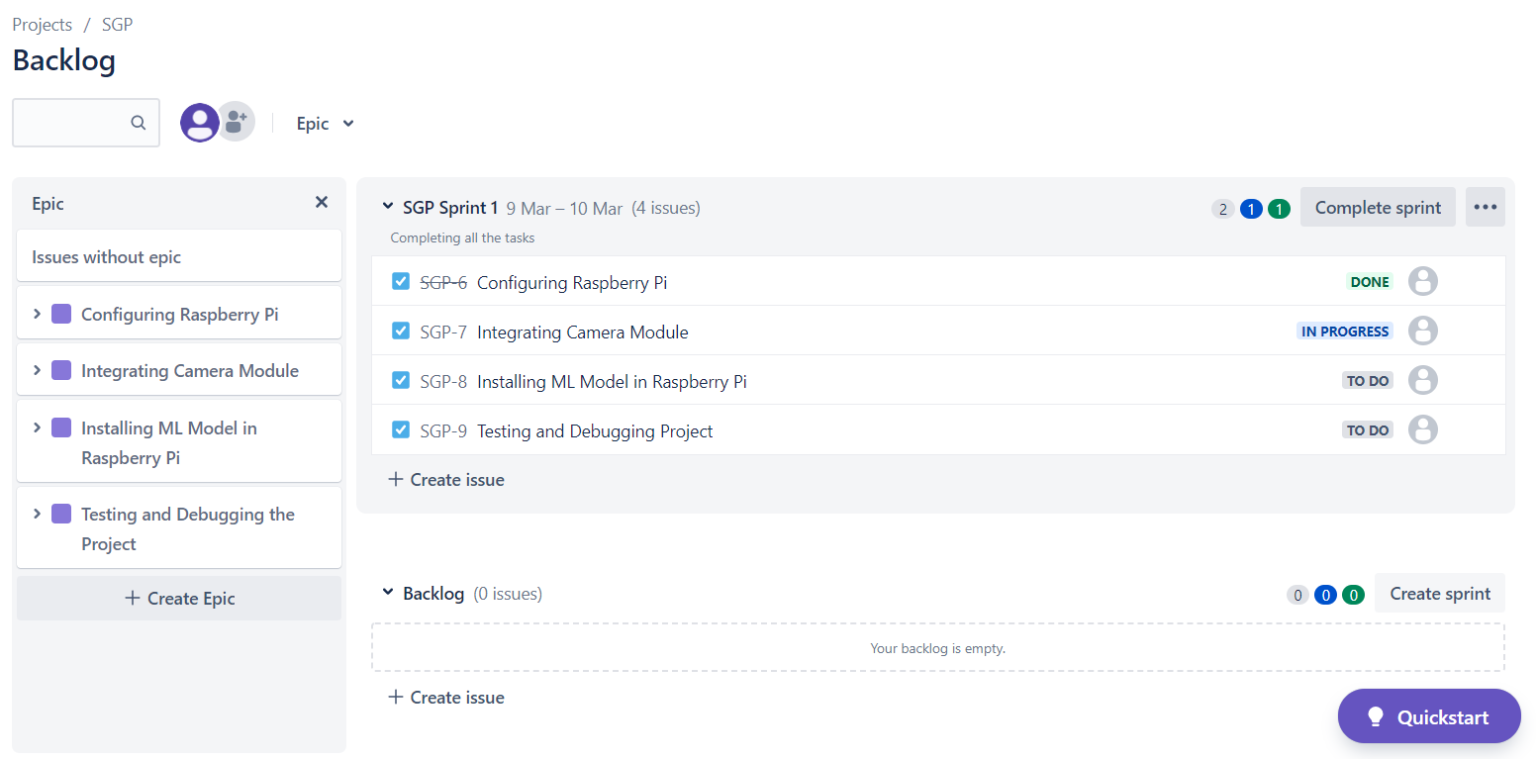
IMPLEMENTATION OF JIRA IN SGP

Slide 15
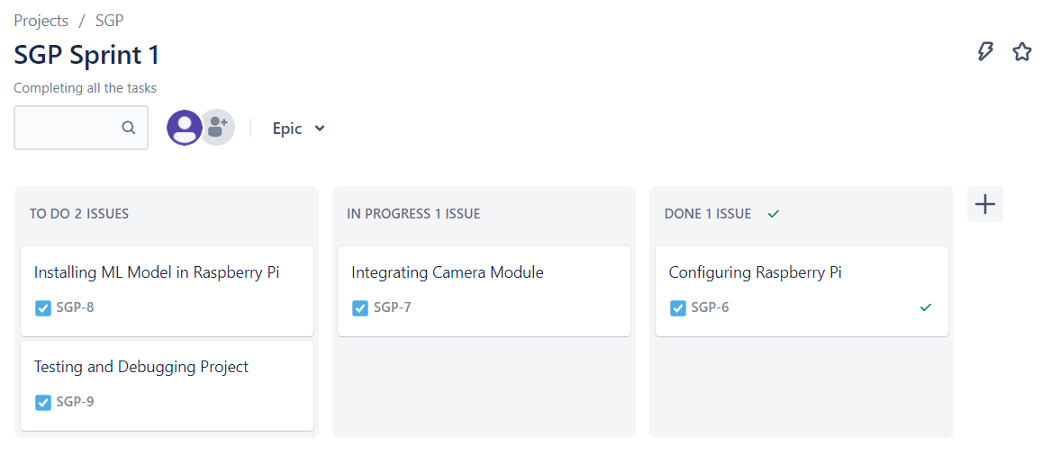
IMPLEMENTATION OF JIRA IN SGP

Slide 16
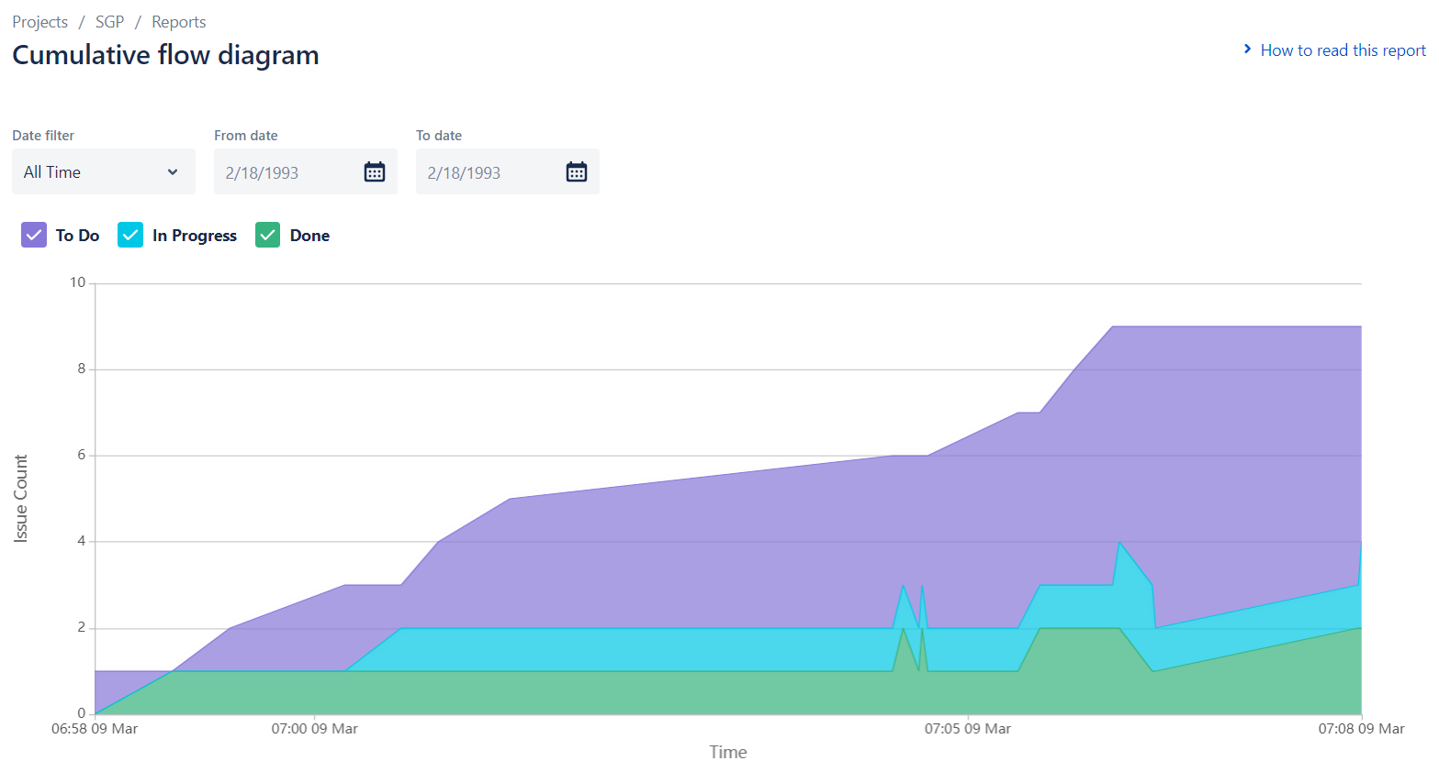

Slide 17
REFERENCES
01
RESEARCHING AGILE MANAGEMENT
https://www.knowledgehut.com/agile-management
02
BENEFITS OF JIRA
https://www.oodlestechnologies.com/blogs/Benefits-Of-Using-JIRA-Tool/
03
JIRA WORKING IN INDUSTRY
https://www.atlassian.com/customers
04
INTRODUCTION TO JIRA
https://www.atlassian.com/software/jira

Slide 18
THANKYOU
Saturn
Saturn has several rings
Earth
Earth is the the third planet
Mercury is the smallest planet

